Slide 1
Acton Health Insurance Trust – Fiscal Health

Slide 2
Health Insurance Trust –
The Health Insurance Trust is Self Insured
It contracts with Blue Cross, Harvard Pilgrim, Tufts to administer programs like PPO’s, HMO’s, HSA’s, Medicare supplements
The Trust sets rates, collects contributions from The Town and District and pays claims. It does not do Plan Design
To protect itself from very large claims the Trust purchases Reinsurance to limit liability to $175,000 per claim
The Trust has an independent Treasurer, a Consultant to advise on rates and programs, and has an annual audit conducted by an independent CPA

Slide 3
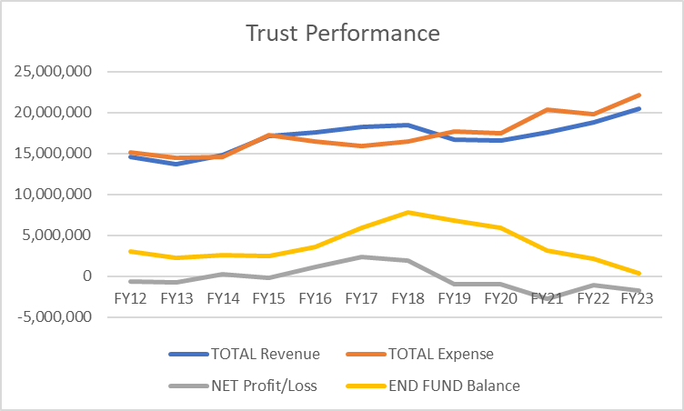
Trust – Financial History

Slide 4
Current Status
Reserves (Undesignated Fund Balance)have fallen to zero
Contribution Rate increases equivalent to 10% annually are not covering cost increases
FY23 claims increase was 9.4% versus -5% in FY22
Loss on Reinsurance Insurance was $1 million versus a loss of $454,000 in FY22 and a profit of $491,000 in FY21
Rapid increase in the level of claims/deficits
Claims for last 3 months 50% higher than the same period in two prior years
Deficits for the first two month of FY24 have totaled $1.5 million
$500,000 of that is reimbursable under stop loss insurance
Some of this is still carryover from HP data breach
New rebate savings program with BCBS will kick in in the second quarter

Slide 5
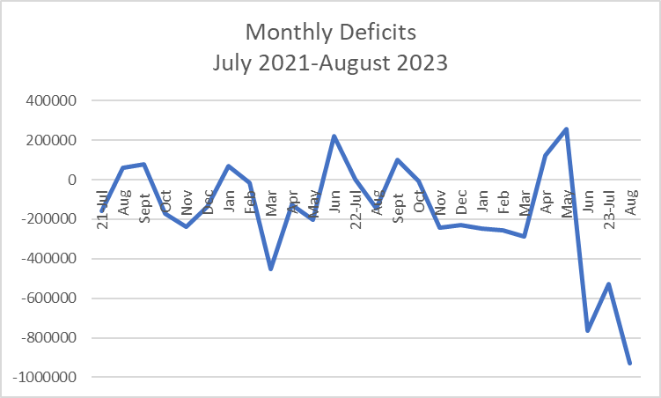
Trust Deficits

Slide 6
What is needed?
To reestablish Reserves to a minimally acceptable level (10%)we need to increase revenue or decrease costs by $2.2 Million
To restore the Trust to a break even basis based on FY23, we need to increase revenue or decrease costs by $1.7 million
Without cost reduction the combined impact on rate would be almost 20%
$2.9 million increase in contributions required from the Town and School District
Employees would see an increase of almost 20%
Individuals $ 50 per month more
Families $ 118 per month more
But based on the last 3 months experience that may not be enough

Slide 7
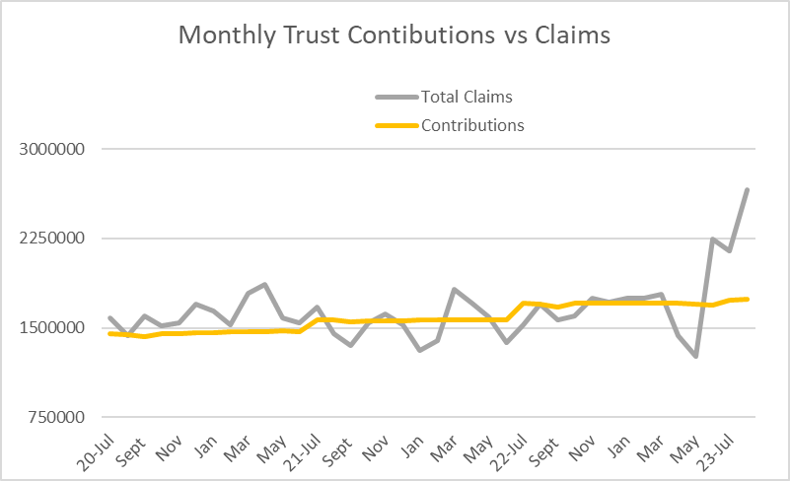
Claims for last 3 months 50% higher than the same period in two prior years

Slide 8
What we know and what we do not know
We Know
Our claims are increasing at alarming rates
Compared to last year we will not lose as much on stop loss Insurance
The rates we charge are not too low
Our rates are comparable to the GIC and West Suburban Health Group for similar plans
We Do Not Know
If the claims increase is due to an increased number large individual claims or a significant increase in utilization by many subscribers

Slide 9
What have we done?
Dec 22- FY24 Rates are increased by 8% $1.6 million
June 23-Revised pricing model change on Pharmacy costs that will save $400,000
June 23-Stop Loss insurance premium for FY24 was held level with last year
June 23-Administrative fees with HP have been reduced, other Trust Admin expenses have been reduced by 18%
July 23-A new Consultant has been engaged to look at all options
October 23-Adopted new retiree coverage model that will save $233,000 for the Trust and an equal amount for the retirees
Developed a series of cost savings options

Slide 10
Options

